Slide 1
DSSTNE: A New Deep Learning Framework For Large Sparse Datasets https://github.com/amznlabs/amazon-dsstne
Scott Le Grand
Senior Scientist
Teza Technologies
scott@teza.com
varelse2005@gmail.com

Slide 2
What?
Yet
Another
Deep Learning Framework?
Well, Yes...

Slide 3
Product Recommendations
What are people who bought items A, B, C...Z most likely to purchase next?
Traditionally addressed with variants of Matrix Factorization, Logistic Regression, Naive Bayes, etc...

Slide 4
So Why Not Neural Networks?*
X_{L+1} = X_{L} * W_{L→L+1}
_{L} = _{L+1} * W_{L→L+1}
W_{L→L+1} = X^{T}_{L} * _{L+1}
*The definitive answer to whether you should take Calculus, Statistics and Linear Algebra in college

Slide 5
Neural Networks For Product Recommendations
Output (10K-10M)
Hidden (100-1K)
Input (10K-10M)

Slide 6
Large Output Layers, Small Hidden Layers
Output (10K-10M)
Hidden (100-1K)
Input (10K-10M)
Existing frameworks were not designed to handle neural networks with input (purchase history) and output (recommendations) layers 10K to 10M units wide because...

Slide 7
This Is A Huge Sparse Data Problem
Uncompressed sparse data either eats a lot of memory or it eats a lot of bandwidth uploading it to the GPU
Naively running networks with uncompressed sparse data leads to lots of multiplications of zero by zero. This wastes memory, power, and time
Product Recommendation Networks can have billions of parameters that cannot fit in a single GPU so summarizing...

Slide 8
Framework Requirements (2014)
Efficient support for large input and output layers
Efficient handling of sparse data (i.e. don't store zero)
Automagic multi-GPU support for large networks and scaling
Avoids multiplying zero and/or by zero
24 hour or less training and recommendations turnaround
Human-readable descriptions of networks

Slide 9
DSSTNE: Deep Sparse Scalable Tensor Network Engine*
A Neural Network framework released into OSS by Amazon in May
Optimized for large sparse data problems and for fully connected layers
Extremely efficient model-parallel multi-GPU support
~6x faster than TensorFlow on such datasets (and that's just on one GTX Titan X GPU, ~15x faster using 4 of them)
100% Deterministic Execution #reproducibilitymatters #noASGD
Full SM 3.x, 5.x, and 6.x support (Kepler or better GPUs)
Distributed training support OOTB (~20 lines of MPI calls #HPCOpenStandardsFTW)
CNN and (Full) RNN support soon based on cuDNN 5.x, maybe some Neon
*”Destiny”

Slide 10
Key Features
Stores networks and data sets in NetCDF format with optional HDF5 support
Multi-GPU handled with MPI and P2P copies
Unapologetic emphasis on fully-connected networks
Dependencies are C++11, CUDA 7.x+, NetCDF, a C++11-aware MPI library, and libjsoncpp
There are no computational shortcuts here, all we're doing is avoiding multiplying by zero and storing zeroes

Slide 11
Describes Neural Networks As JSON Objects
{
"Version" : 0.7,
"Name" : "AE",
"Kind" : "FeedForward",
"SparsenessPenalty" : {
"p" : 0.5,
"beta" : 2.0
},
"ShuffleIndices" : false,
"Denoising" : {
"p" : 0.2
},
"ScaledMarginalCrossEntropy" : {
"oneTarget" : 1.0,
"zeroTarget" : 0.0,
"oneScale" : 1.0,
"zeroScale" : 1.0
},
"Layers" : [
{ "Name" : "Input", "Kind" : "Input", "N" : "auto", "DataSet" : "input", "Sparse" : true },
{ "Name" : "Hidden", "Kind" : "Hidden", "Type" : "FullyConnected", "N" : 128, "Activation" : "Sigmoid", "Sparse" : true },
{ "Name" : "Output", "Kind" : "Output", "Type" : "FullyConnected", "DataSet" : "output", "N" : "auto", "Activation" : "Sigmoid", "Sparse" : true }
],
"ErrorFunction" : "ScaledMarginalCrossEntropy"
}

Slide 12
AlexNet As A JSON Object*
{
"Version" : "0.8"
"Name" : "AlexNet"
"Kind" : "FeedForward"
"LocalResponseNormalization" :
{
"k" : 2,
"n" : 5,
"alpha" : 0.0001,
"beta" : 0.75
},
"Layers" : [
{ "Kind" : "Input", "N" : [224, 224, 3], "DataSet" : "ImageNet_input"},
{ "Kind" : "Hidden", "Type" : "Convolutional", "N" : 96, "Kernel" : [11, 11], "KernelStride" : [4, 4], "Activation" : "Relu" }
{ "Kind" : "Pooling", "Function" : "Max", "Kernel" : [2, 2] },
{ "Kind" : "Pooling", "Function" : "LocalResponseNormalization" },
{ "Kind" : "Hidden", "Type" : "Convolutional", "N" : 256, "Kernel" : [5, 5], "Activation" : "Relu" },
{ "Kind" : "Pooling", "Function" : "Max", "Kernel" : [2, 2] },
{ "Kind" : "Pooling", "Function" : "LocalResponseNormalization" },
{ "Kind" : "Hidden", "Type" : "Convolutional", "N" : 384, "Kernel" : [3, 3], "Activation" : "Relu" },
{ "Kind" : "Hidden", "Type" : "Convolutional", "N" : 384, "Kernel" : [3, 3], "Activation" : "Relu" },
{ "Kind" : "Hidden", "Type" : "Convolutional", "N" : 256, "Kernel" : [3, 3], "Activation" : "Relu" },
{ "Kind" : "Pooling", "Function" : "Max", "Kernel" : [2, 2] },
{ "Kind" : "Hidden", "Type" : "FullyConnected", "N" : 4096, "Activation" : "Relu", "pDropout" : 0.5 },
{ "Kind" : "Hidden", "Type" : "FullyConnected", "N" : 4096, "Activation" : "Relu", "pDropout" : 0.5 },
{ "Kind" : "Output", "Type" : "FullyConnected", "N" : 1000, "DataSet" : "ImageNet_output", "Activation" : "SoftMax" }
]
"ErrorFunction" : "CrossEntropy"
}
*Accidentally similar to Andrej Karpathy's ConvnetJS framework

Slide 13
Human-Readable Doesn't Suck..
name: "AlexNet"
layer {
name: "data"
type: "Input"
top: "data"
input_param { shape: { dim: 10 dim: 3 dim: 227 dim: 227 } }
}
layer {
name: "conv1"
type: "Convolution"
bottom: "data"
top: "conv1"
param {
lr_mult: 1
decay_mult: 1
}
param {
lr_mult: 2
decay_mult: 0
}
convolution_param {
num_output: 96
kernel_size: 11
stride: 4
}
}
layer {
name: "relu1"
type: "ReLU"
bottom: "conv1"
top: "conv1"
}
layer {
name: "norm1"
type: "LRN"
bottom: "conv1"
top: "norm1"
lrn_param {
local_size: 5
alpha: 0.0001
beta: 0.75
}
}
layer {
name: "pool1"
type: "Pooling"
bottom: "norm1"
top: "pool1"
pooling_param {
pool: MAX
kernel_size: 3
stride: 2
}
}
layer {
name: "conv2"
type: "Convolution"
bottom: "pool1"
top: "conv2"
param {
lr_mult: 1
decay_mult: 1
}
param {
lr_mult: 2
decay_mult: 0
}
convolution_param {
num_output: 256
pad: 2
kernel_size: 5
group: 2
}
}
layer {
name: "relu2"
type: "ReLU"
bottom: "conv2"
top: "conv2"
}
layer {
name: "norm2"
type: "LRN"
bottom: "conv2"
top: "norm2"
lrn_param {
local_size: 5
alpha: 0.0001
beta: 0.75
}
}
layer {
name: "pool2"
type: "Pooling"
bottom: "norm2"
top: "pool2"
pooling_param {
pool: MAX
kernel_size: 3
stride: 2
}
}
layer {
name: "conv3"
type: "Convolution"
bottom: "pool2"
top: "conv3"
param {
lr_mult: 1
decay_mult: 1
}
param {
lr_mult: 2
decay_mult: 0
}
convolution_param {
num_output: 384
pad: 1
kernel_size: 3
}
}
layer {
name: "relu3"
type: "ReLU"
bottom: "conv3"
top: "conv3"
}
layer {
name: "conv4"
type: "Convolution"
bottom: "conv3"
top: "conv4"
param {
lr_mult: 1
decay_mult: 1
}
param {
lr_mult: 2
decay_mult: 0
}
convolution_param {
num_output: 384
pad: 1
kernel_size: 3
group: 2
}
}
layer {
name: "relu4"
type: "ReLU"
bottom: "conv4"
top: "conv4"
}
layer {
name: "conv5"
type: "Convolution"
bottom: "conv4"
top: "conv5"
param {
lr_mult: 1
decay_mult: 1
}
param {
lr_mult: 2
decay_mult: 0
}
convolution_param {
num_output: 256
pad: 1
kernel_size: 3
group: 2
}
}
layer {
name: "relu5"
type: "ReLU"
bottom: "conv5"
top: "conv5"
}
layer {
name: "pool5"
type: "Pooling"
bottom: "conv5"
top: "pool5"
pooling_param {
pool: MAX
kernel_size: 3
stride: 2
}
}
layer {
name: "fc6"
type: "InnerProduct"
bottom: "pool5"
top: "fc6"
param {
lr_mult: 1
decay_mult: 1
}
param {
lr_mult: 2
decay_mult: 0
}
inner_product_param {
num_output: 4096
}
}
layer {
name: "relu6"
type: "ReLU"
bottom: "fc6"
top: "fc6"
}
layer {
name: "drop6"
type: "Dropout"
bottom: "fc6"
top: "fc6"
dropout_param {
dropout_ratio: 0.5
}
}
layer {
name: "fc7"
type: "InnerProduct"
bottom: "fc6"
top: "fc7"
param {
lr_mult: 1
decay_mult: 1
}
param {
lr_mult: 2
decay_mult: 0
}
inner_product_param {
num_output: 4096
}
}
layer {
name: "relu7"
type: "ReLU"
bottom: "fc7"
top: "fc7"
}
layer {
name: "drop7"
type: "Dropout"
bottom: "fc7"
top: "fc7"
dropout_param {
dropout_ratio: 0.5
}
}
layer {
name: "fc8"
type: "InnerProduct"
bottom: "fc7"
top: "fc8"
param {
lr_mult: 1
decay_mult: 1
}
param {
lr_mult: 2
decay_mult: 0
}
inner_product_param {
num_output: 1000
}
}
layer {
name: "prob"
type: "Softmax"
bottom: "fc8"
top: "prob"
}
278 Lines
TSCR (Too Small Couldn't Read): 278 Lines of Code...

Slide 14
JSON API Is Just An Interface to DSSTNE
struct NNNetworkDescriptor
{
string _name; // Optional name for neural network
NNNetwork::Kind _kind; // Either AutoEncoder or FeedForward (default)
ErrorFunction _errorFunction; // Error function for training
vector<NNLayerDescriptor> _vLayerDescriptor; // Vector containing neural network layers
vector<NNWeightDescriptor> _vWeightDescriptor; // Vector containing preloaded weight data
bool _bShuffleIndices; // Flag to signal whether to shuffle training data or not
uint32_t _maxout_k; // Size of Maxout (default 2)
NNFloat _LRN_k; // Local Response Normalization offset (default 2)
uint32_t _LRN_n; // Local Response Normalization spread (default 5)
NNFloat _LRN_alpha; // Local Response Normalization scaling (default 0.0001)
NNFloat _LRN_beta; // Local Response Normalization exponent (default 0.75)
bool _bSparsenessPenalty; // Specifies whether to use sparseness penalty on hidden layers or not
NNFloat _sparsenessPenalty_p; // Target sparseness probability for hidden layers
NNFloat _sparsenessPenalty_beta; // Sparseness penalty weight
bool _bDenoising; // Specifies whether to use denoising on input layers
NNFloat _denoising_p; // Probability of denoising inputs (for sparse layers, only denoise on non-zero values)
NNFloat _deltaBoost_one; // Adjusts scaling of nonzero-valued outputs
NNFloat _deltaBoost_zero; // Adjusts scaling of zero-valued outputs
NNFloat _SMCE_oneTarget; // Relaxed target for non-zero target values (Default 0.9)
NNFloat _SMCE_zeroTarget; // Relaxed target for zero target values (Default 0.1)
NNFloat _SMCE_oneScale; // Scaling factor for non-zero target values (Default 1.0)
NNFloat _SMCE_zeroScale; // Scaling factor for zero target values (Default 1.0)
string _checkpoint_name; // Checkpoint file name
int32_t _checkpoint_interval; // Number of epochs between checkpoints
int32_t _checkpoint_epochs; // Number of epochs since last checkpoint
NNNetworkDescriptor();
};
DSSTNE's Engine is fully API-Agnostic, moving on...

Slide 15
Amazon's Definition Of Sparsity
0.01% to 0.1% Density, far lower than the optimal sparsity for the cuSparse library (too cuSlow)
Sparse data stored in CSR format (Index, value) or just indices
Sparse SGEMM is 5-20x faster than a full SGEMM depending on density
Sparse input layers are nearly “free”

Slide 16
Sparse Neural Network Training*
X_{L+1} = X_{L} * W_{L→L+1}
W = X^{T}_{L} * _{L+1}
*Sparse output layers are easy (exercise for the listener)

Slide 17
Sparse X_{L+1} = X_{L} * W_{L→L+1}
X
=

Slide 18
Sparse W = X^{T}_{L} * _{L+1}
Need to transpose X_{L} matrix in parallel
This is easy to do with atomic ops
But the transpose ordering is not deterministic
Solution: use 64-bit fixed point summation because fixed point accumulation is associative (A + B + C) == (C + A + B) etc

Slide 19
Sparse W = X^{T}_{L} * _{L+1}
X
=

Slide 20
Model Parallel vs Data Parallel
Amazon Product Categories range from 10K to 10M items
Amazon Catalog is billions of items
GPUs have up to 12 GB of memory
All the interesting problems need > 12GB of memory
Therefore ASGD is not an option
Data Parallel Implementation unacceptably slow

Slide 21
One Weird Trick For Model Parallelism*
To parallelize an SGEMM operation, one first shards the input data across all N GPUs
W1
X_{L}
X_{L1}
X_{L2}
X_{L3}
X_{L4}
*Apologies to Alex Krizhevsky

Slide 22
There Are Two Ways To Shard The Weights
W1
W₁
W₂
W
W₁
W₂
W₃
W₄
W
W₃
W₄

Slide 23
Output Layer Larger Than Input Layer? allGather* Input Layer Data Then SGEMM
X_{L+1}
X_{L}
W1
W1
W1
=
X_{L1}
X_{L2}
X_{L3}
X_{L4}
W₁
*
X_{L+1 1}
*Using custom 2d allGather code, not NCCL/MPI

Slide 24
Input Layer Larger Than Output Layer?
SGEMM Then Reduce Outputs*
X_{L+1}
X_{L}
W1
W₁
*
=
X_{L+1 1}
X_{L1}
*Using custom 2D partial reduction code which is also O(n)

Slide 25
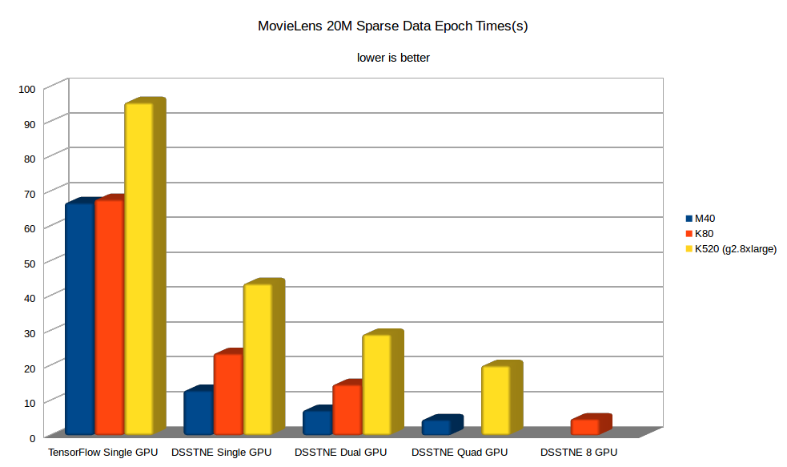
How Well Does it Work?

Slide 26
Yes Yes But How Good Are The Recommendations?
This is a strange question IMO
DSSTNE runs the same mathematics as everyone else
Amazon OSSed the framework, not the actual networks, and definitely not how they prepare customer purchase histories
So for a surrogate, let's use the binary prediction of a random 80/20 split of the MovieLens 20M dataset
Competing numbers provided by Saul Vargas

Slide 27
MovieLens 20M DSSTNE
{
"Version" : 0.8,
"Name" : "AIV NNC",
"Kind" : "FeedForward",
"ShuffleIndices" : false,
"ScaledMarginalCrossEntropy" : {
"oneTarget" : 1.0,
"zeroTarget" : 0.0,
"oneScale" : 1.0,
"zeroScale" : 1.0
},
"Layers" : [
{ "Name" : "Input", "Kind" : "Input", "N" : "auto", "DataSet" : "input", "Sparse" : true },
{ "Name" : "Hidden1", "Kind" : "Hidden", "Type" : "FullyConnected", "N" : 1536, "Activation" : "Relu", "Sparse" : false, "pDropout" : 0.37, "WeightInit" : { "Scheme" : "Gaussian", "Scale" : 0.01 } },
{ "Name" : "Hidden2", "Kind" : "Hidden", "Type" : "FullyConnected", "N" : 1536, "Activation" : "Relu", "Sparse" : false, "pDropout" : 0.37, "WeightInit" : { "Scheme" : "Gaussian", "Scale" : 0.01 } },
{ "Name" : "Hidden3", "Kind" : "Hidden", "Type" : "FullyConnected", "N" : 1536, "Activation" : "Relu", "Sparse" : false, "pDropout" : 0.37, "WeightInit" : { "Scheme" : "Gaussian", "Scale" : 0.01 } },
{ "Name" : "Output", "Kind" : "Output", "Type" : "FullyConnected", "DataSet" : "output", "N" : "auto", "Activation" : "Sigmoid", "Sparse" : true , "WeightInit" : { "Scheme" : "Gaussian", "Scale" : 0.01, "Bias" : -10.2 }}
],
"ErrorFunction" : "ScaledMarginalCrossEntropy"
}

Slide 28
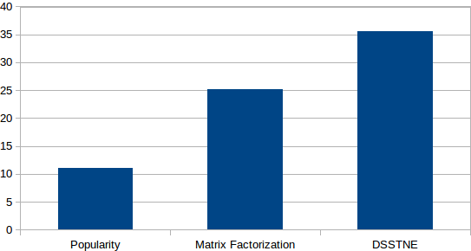
MovieLens 20M P@10
https://github.com/RankSys/RankSys

Slide 29
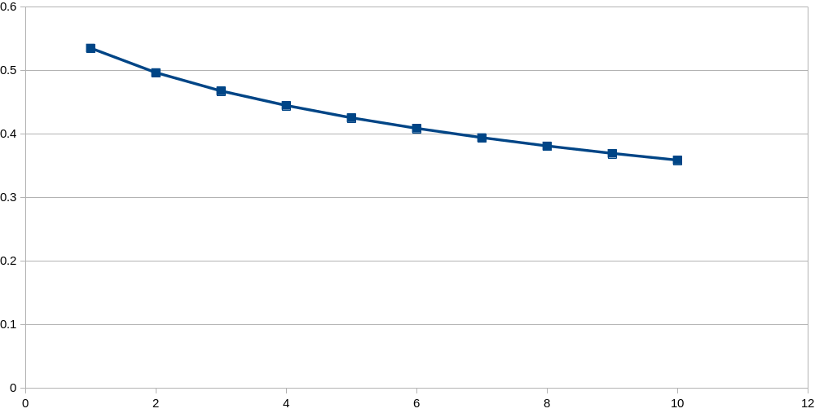
Raw Performance
P@K
K

Slide 30
AWS Recommendations at Scale
AWS has just released a blog by Kiuk Chung on how to perform product recommendations with DSSTNE (and other frameworks BTW) and Spark to experiment with deep learning for product recommendations at scale
Amazon uses DSSTNE for most of this, and Keras for networks based on features not yet implemented in DSSTNE (LSTM/GRU)
http://blogs.aws.amazon.com/bigdata/post/TxGEL8IJ0CAXTK/Generating-Recommendations-at-Amazon-Scale-with-Apache-Spark-and-Amazon-DSSTNE

Slide 31
DSSTNE RoadMap
Add CNN/Pooling/LSTM support through cuDNN maybe Neon for Maxwell or better because #3xfaster
Provide a Python API
Caffe/TensorFlow import
Automagic streaming of both models and datasets with Pascal Unified Memory

Slide 32
Summary
DSSTNE's Model-parallel training is a big win
DSSTNE's Efficient sparse data handling is a big win
Both of these required bespoke GPU code
AWS has released all the tools for using DSSTNE for recommendations at scale
Torch and Caffe have recently improved their sparse data support

Slide 33
Acknowledgments (DSSTNE/Amazon)
Matias Benitez
Jeff Bezos
Kiuk Chung
Leo Dirac
Rejith Joseph George
Mitchell Goodman
Sebastian Gunningham
Shruti Kamath
Cesar Romero
Oleg Rybakov
Srikanth Thirumulai
Henri Yandell
Jane You

Slide 34
Acknowledgments (NVIDIA)
Jonathan Bentz
Mark Berger
Jerry Chen
Kate Clark
Simon Layton
Duncan Poole
Sarah Tariq

Slide 35
Other Other Model Parallel
Layer by layer subdivision of network
Supported by Tensorflow and Chainer

Slide 36
One Weird(er) Trick*
W_{L->L+1:1}
W1
X_{L:1}
X
=
X_{L+1:1}
X_{L+1:2}
X_{L+1:3}
X_{L+1:4}
1
2
1
2
1
2
1
2
4
3
4
3
4
3
4
3
* Reduce the outputs over N-1 communication steps if the model outputs
are smaller than the model inputs

Slide 37
And the other Weirder Trick*
W1
W1
W1
X_{L:1}
X_{L:2}
X_{L:3}
X_{L:4}
X
W_{L->L+1:1}
=
X_{L+1:1}
1
2
1
2
1
2
1
2
4
3
4
3
4
3
4
3
*Scatter the inputs over N-1 communication steps if the model inputs are smaller than the model outputs

Slide 38
Overlap Computation/Communication
TitanX is ~6.6 TFLOPS
PCIE BW is ~12.5 GB/s if you don't buy crap HW
6.6 TFLOPS / 3.125 Gfloats ~= 2000 FLOPS
So if you have ~1000 FMADs per output per GPU, you can run at SOL*
*This requires efficient SGEMM, cuBLAS is fraught, Neon isn't though...

Slide 39
Do you need a DGX-1?
85 TFLOPS FP32 (10.6 TFLOPS per GPU) no FP16 for now
80 GB/s connected in a cube (N == 8)
Significant reduction in communication costs, but is AlexNet communication-limited?
Reduction:
Gather:
AllReduce:
D * (N – 1) / N
D * (N – 1) / N
D * 2 * (N – 1) / N

Slide 40
Are you data-parallel?
AlexNet has ~61M parameters
We'll assume a batch size of 128 and Soumith Chintala's training perf numbers for TitanX scaled up by ~1.6 to arrive at 2,884 images/s FP32
16 images at 2,884 images/s is ~5.5 ms
AllReducing 61M (244 MB) parameters at ~64 GB/s is ~6.7 ms (buried 5.5 ms of backprop for overlapping copy and compute) for a final result of 1.2 ms.
Using 12.5 GB/s P2P, this would take ~34 ms, $129K is a bargain!

Slide 41
Alex Krizhevsky to the Rescue!
(or are you model-parallel?)
AlexNet has ~61M parameters. ~4.3M of which are convolutional (data-parallel) and ~56.7M of which are fully-connected (model-parallel)
Fully connected layers at a batch size of 128 is ~1.7M neurons
P2P allReduce of 4.3M parameters takes ~2.4 ms
P2P gather/reduction of 1.7M neurons is ~0.5 ms
2.9 ms is << 5.5 ms so once again it's free(tm)
It's also faster than NVLINK data-parallel…
NVLINK model-parallel would of course win...

